Slide 1

South Croydon Community Association (SCCA)
Annual General Meeting (AGM)
6th March 2025
7:30pm

Slide 2

Agenda
Time | Item | Lead
7:30 - 7:45 | Networking / last minute membership signups | n/a
7:45 - 7:55 | Welcome & Chairperson’s report | José
7:55 – 8:00 | Treasurer’s presentation of accounts | Josi
8:00 – 8:10 | Upcoming events and volunteering opportunities | Bex
8:10 – 8:30 | Topics for discussion: New committee member & volunteers Funding ideas discussion Road Safety & Pollution around Aberdeen / Temple Road | Various
8:30 | Closing Remarks | José

Slide 3
Welcome & Chairperson’s Report
José Sanchez Loureda

Slide 4
Welcome to our 2025 AGM
We’re delighted to have you with us today as we celebrate our achievements, share new developments, and set a vision for the future. We appreciate your time and look forward to your active participation.
Housekeeping Notes:
Mobile Devices: Please switch your phones to silent to avoid disruptions.
Emergency Procedures: In the event of an alarm, please follow staff instructions and proceed calmly to the nearest exit.
Member Topics for Discussion: There will be a dedicated section to discuss member led topics and Q&A. We value your insights - feel free to speak up.
Thank you for joining us. Let’s make this AGM both collaborative and inspiring!

Slide 5
Reflections on the Past Year
Growth & Engagement
Increase in membership, both individual and business members
Heartfelt thanks to our dedicated volunteers and members
Community Outreach
Successful local community gatherings
Supporting local members with planning and council matters
Progress with the local council on the community noticeboard
South Cronx newsletter highlighting local events and news
Online Presence
Updated website and improved communication channels to keep everyone informed (e.g., newsletter sign-ups, social media).

Slide 6





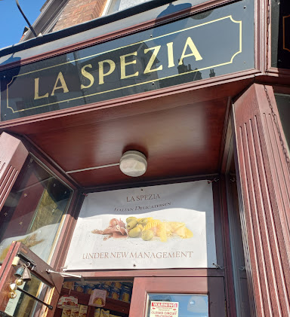


Impact
Memberships
We have grown individual membership from 0 to 32
We launched a new business membership, and are encouraged by the reception we have received, signing up 8 new members in the last 9 months
Impact - We have continued to grow our social reach and impact (last 90 days):
Facebook: Over 115k views, and 10k engagement
Instagram: 7,000 views, over 1,700 accounts reached
Web: 1,100 views and over 200 unique visitors

Slide 7
Events & Accomplishments
Environmental Initiatives
Regular litter picks and awareness campaigns to keep South Croydon tidy
Community Events celebrating the local area
Family visits organised to the Croydon Fire Station
Tour of the bells at St Peter’s Church
Planning and Council Matters
Supported members with planning requests in collaboration with the Council (objecting to further HMOs, road safety [more details later])

Slide 8
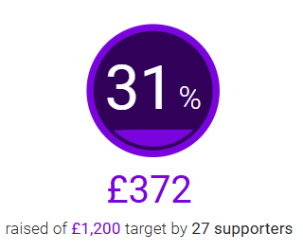
Fundraising
Community Noticeboard fundraiser
Crowdfunding initiative has so far raised £372
In discussion with businesses to provide further donations
Ready now to submit planning consent after discussion with local councillors and planning team
Other sources
A further two submissions planned to grant giving bodies
More to be done, let’s discuss fundraising ideas!

Slide 9
Vision for 2025
Growth & Engagement
Continue to increase volunteers and members, strengthening community
Engage further into the South Croydon business community & schools
Community Outreach
Increase the reach, scale and variety of our events
Grow as a trusted partner to support local members with the Council
Successfully install and commission the community noticeboard!
Aspirationally, secure additional funding from granting bodies
Online Presence
Continue celebrating and advocating for local issues online
Convert more online followers and web visitors to members

Slide 10
Presentation of accounts
Josi Kiss

Slide 11
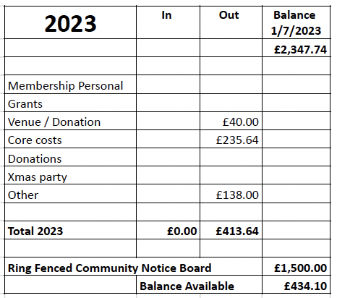
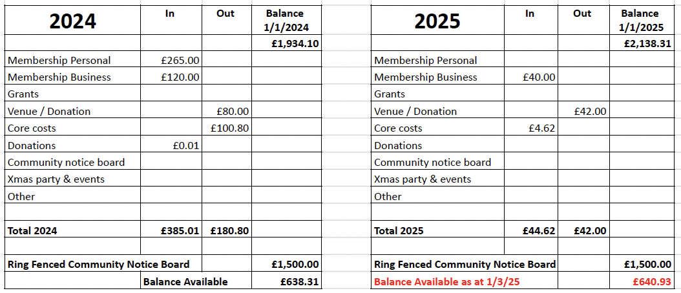
Overview of accounts up to FY2025

Slide 12
Upcoming events & volunteering opportunities
Bex de Paula Hanika

Slide 13

Upcoming Events
Spring Social!
Litter Picks
Volunteering
Ideas to support local schools & businesses
Items to discuss with the council

Slide 14


Upcoming Events
Fire Station Visit
Coffee & Tea Clubs

Slide 15
Proposed Events
Community Events celebrating the local area
History talk at Haling Grove (21 September)
General History talk St Augustine's (22 March)
Proposed trip in a police launch on the river Thames
Proposed South End Croydon History Walk & Talk
Proposed Whitgift School visit
Co-events with local institutions such as St Peters
Delivering free online webinars on how to create a website
And others!

Slide 16
Other opportunities to get involved
Help with the Police Ward Panel
Work with the Police on a Speed Watch
St Augustine's Church - Choir & Knitting Group
St Peter’s Church - Book Club, Gardeners or join the Choir or the Bell Ringers!
Volunteer at South Croydon Day Centre for the Elderly
Help with the Lloyd Park Park Run
Highlight local common areas for planting
Donate plants and flowers for local parks
Join a friends group - e.g Friends of Park Hill or Friends of Haling Grove

Slide 17
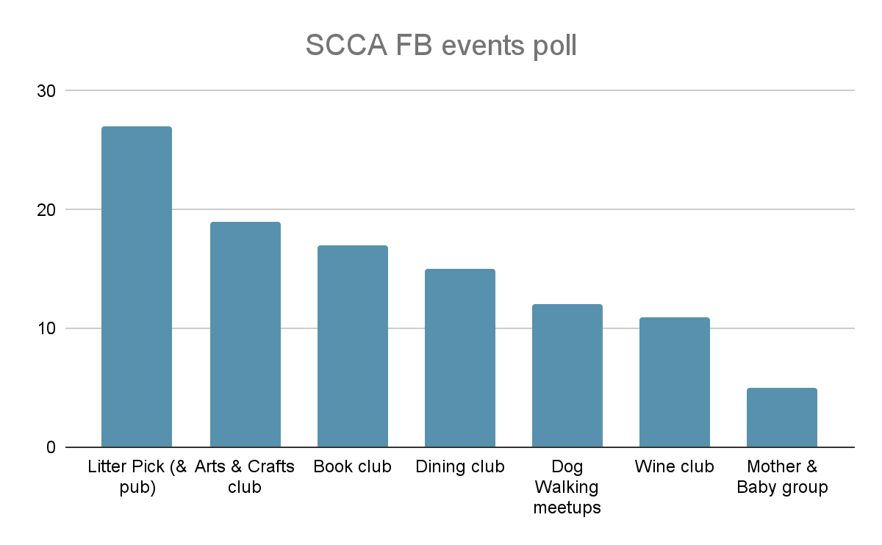
Activities and Events
We carried out a FB poll with the following results
Other suggestions
Volunteering
Ideas to support local schools & businesses
Items to discuss with the council

Slide 18
Member Topics for Discussion
José Sanchez Loureda

Slide 19
New Committee Members / Volunteers
Last call for any Members that would like to stand for the Committee, or join as volunteers to help us organise events
If any Full Members here tonight who haven’t nominated themselves wants to do so for any position, please shout!
Alternatively, let’s have an informal chat after the AGM in the pub :)
Note: Only Full Members and Business Members may now vote in the new committee.

Slide 20
Funding Ideas Discussion
We can apply for funding from £300 to £20,000 to deliver a new or existing activity or to support our organisation to change and adapt to new and future challenges.
We can get funding for projects that’ll do at least one of these things:
bring people together to build strong relationships in and across communities
improve the places and spaces that matter to communities
help more people to reach their potential, by supporting them at the earliest possible stage
support people, communities and organisations facing more demands and challenges because of the cost-of-living crisis.

Slide 21
Road Safety & Pollution around Aberdeen / Temple Road
Local resident and member Laura Sawyer has raised the issue of road safety around Aberdeen / Heathfield / St Peters Road
Excessive speeding in these side roads
Large number of commercial vehicles / buses using them
Danger to local schools & families
Surface getting worn out
We are supporting Laura with a petition to get this heard at the Council, please lend us your support!

Slide 22
Closing Remarks
José Sanchez Loureda

Slide 23
Closing thoughts
A big thank you to everyone present tonight, especially those that have volunteered and contributed to our discussions
We will be in touch with updates and will encourage further conversation on future activities
With all your support and energy we look forward to working together for the benefit of the South Croydon community, and have fun doing so.
If you are able to, please join us for a drink!

Slide 24
Close
You’re welcome to join us at the pub!

